Slide 1
Meeting 03/08/2020
Naudé Conradie
19673418

Slide 2
CpPN
Implemented in Numpy
Scale
1:1
Activation functions
Sin
Cos
Tanh
Sigmoid
Relu
Number of layers

Slide 3
CPPN
Resulting grid
Managed with random seed
Desired dimensions
Array of floats between 0 and 1
Round up or down
Evolution

Slide 4
L-Systems
Random generation
Select random axiom
1 or 2 rules
F
Possibly f
Rules constructed from subunits
F | f | fF | Ff
+ | - | ++ | --
[F] |  | [f]
[+F] | [+fF] | [-F] | [-fF]

Slide 5
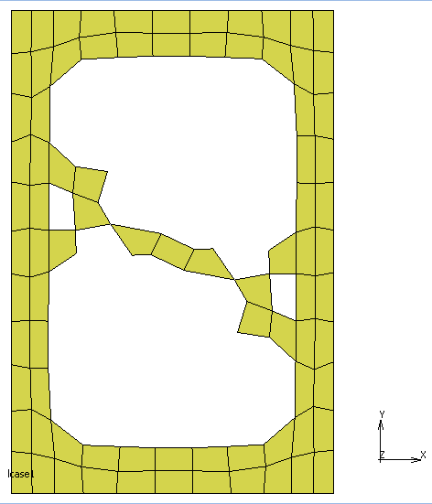
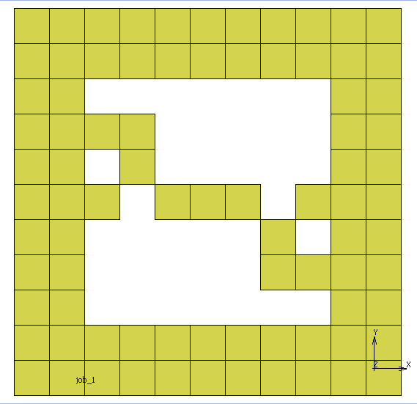
L-System Examples – Case 1
Number of elements removed: | 38
Axiom: | --[F]++++[F] | Rotated vertically
Rules: | F | FFf[f]--
 | f | [+fF][f][+F][+F]

Slide 6
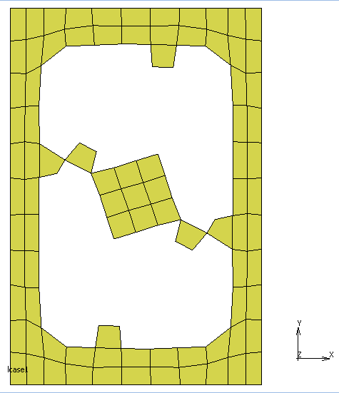
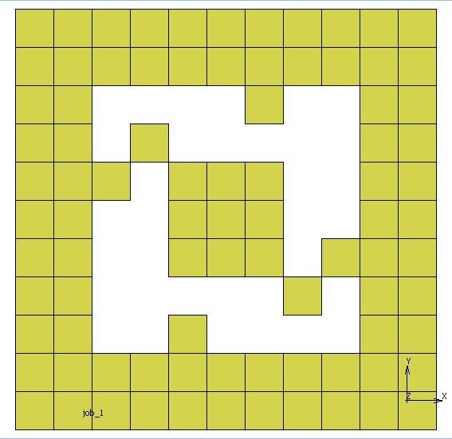
L-System Examples – Case 1
Number of elements removed: | 34
Axiom: | [F]++++[F] | Rotated horizontally
Rules: | F | [-F]F--f
 | f | [f]+fFf

Slide 7
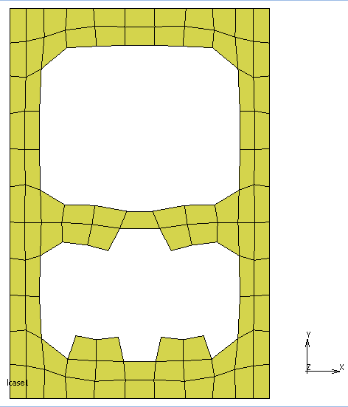
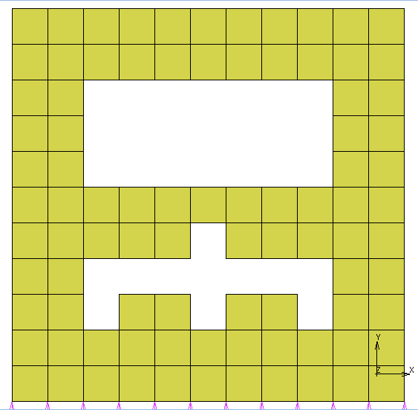
L-System Examples – Case 1
Number of elements removed: | 32
Axiom: | --[F]++++(F) | Mirrored vertically
Rules: | F | --+++Ff
 | f | [+F]F[+F]F

Slide 8
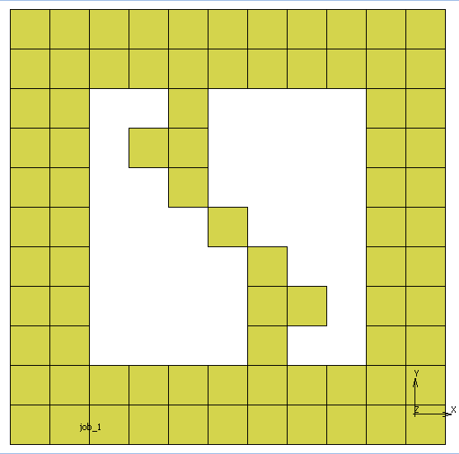
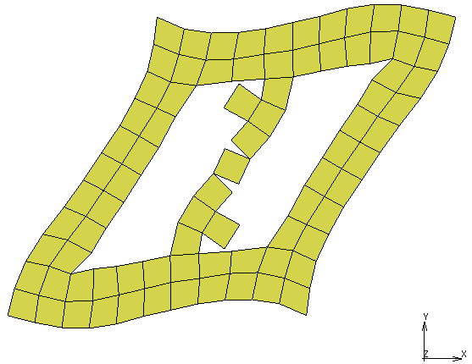
L-System Examples – Case 2
Number of elements removed: | 40
Axiom: | +[F]++++[F] | Rotated diagonally
Rules: | F | FFFf[f]
 | f | ++--F+

Slide 9
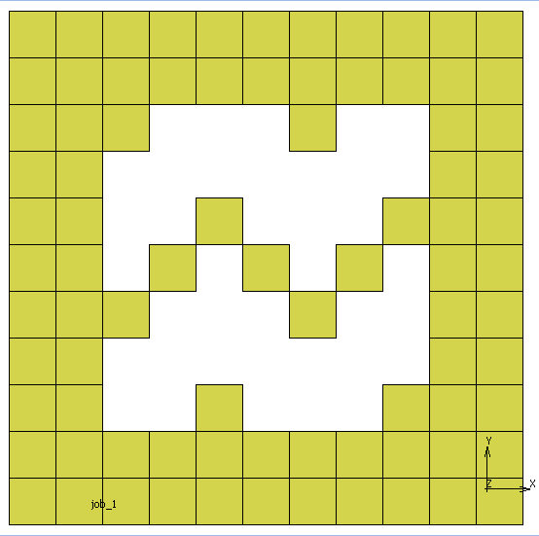
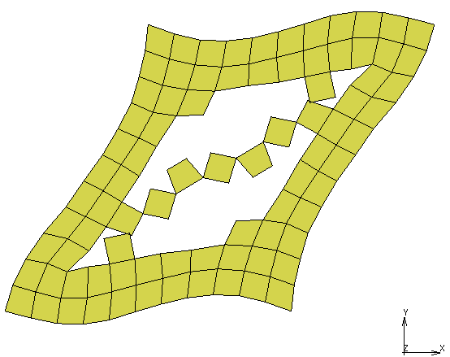
L-System Examples – Case 2
Number of elements removed: | 38
Axiom: | --[F]++++[F] | Rotated vertically
Rules: | F | FfFf-[+F]
 | f | F[-F][F][-fF]

Slide 10
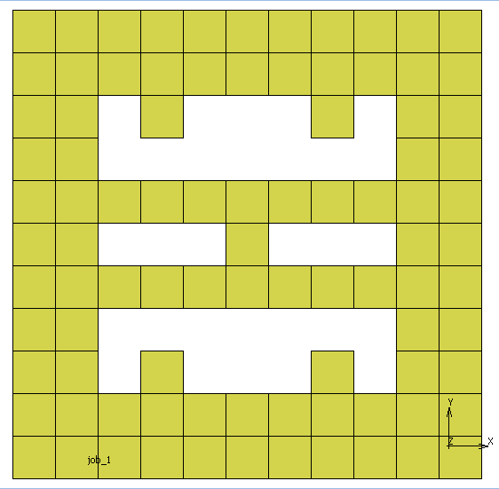
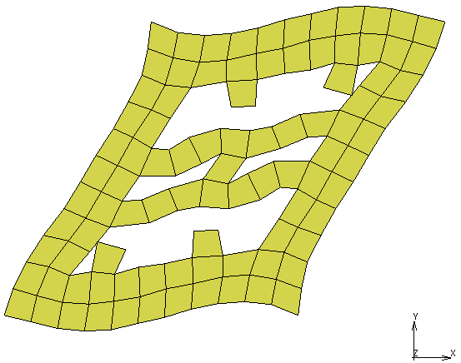
L-System Examples – Case 2
Number of elements removed: | 30
Axiom: | +[F]++(F)++[F]++(F) | Mirrored diagonally and negative diagonally
Rules: | F | FFf--+
 | f | fF[+F][f]+

Slide 11
L-Systems
Prove similar behaviour at different scales
Decrease number of recursions
Decrease complexity of rules

Slide 12
Lab Work
Use David’s model for now
Potentially do some testing near the end of the project
Testing procedure for models
Safety report
3D printed moulds
Glass plate fixture
Pressurise

Slide 13
Admin
Lodric Roux
Online meeting
Discussed L-systems and coding
Meeting again this week
Cornel Herbst
No communication yet

Slide 14
Admin
New meeting time
Mondays 10:00
Demi hours
Wednesdays 09:00-11:00
One other hour (TBD)
Examination procedures
Online oral examination
Submission date

